Slide 1
Designing Custom Circuit Boards
Michael Johnson-Moore
Presented Feb. 20, 2025 at StudentSPEAK
Elliot T. Bowers Honors College
Sam Houston State University
Notes:
Everything in this presentation is simplified for laypeople.

Slide 2
Thanks And Acknowledgements
Elliot T. Bowers Honors College
Funding
Hosting this presentation
Dr. Iftekhar Basith
Faculty Advisor
Dean Bell
Allowing me to do a thesis on this project.

Slide 3
Thanks And Acknowledgements
American Society for Engineering Education
Peer Review and Future Presentation (hopefully)
Montreal, Canada, June 22-25, 2025
Paper already accepted
Pabasar S.
Artist of Title Font “Cirquee”

Slide 4
Full Project Overview
2:01

Slide 5
Full Project Overview
This
Presentation
Research
Project

Slide 6


Full Project Overview
Modular Robotic Arm
Robotics experience
AI Experience
Future Prosthetics?

Slide 7
Full Project Overview
Modular Robotic Arm
Rigid Limb Segments

Slide 8
Full Project Overview
Modular Robotic Arm
Rigid Limb Segments

Slide 9
Full Project Overview
Modular Robotic Arm
Rigid Limb Segments

Slide 10
Full Project Overview
Modular Robotic Arm
Rigid Limb Segments

Slide 11
Full Project Overview
Modular Robotic Arm
Rigid Limb Segments

Slide 12
Full Project Overview
Modular Robotic Arm
Rigid Limb Segments

Slide 13
Full Project Overview
Modular Robotic Arm
Rigid Limb Segments

Slide 14
Full Project Overview
Modular Robotic Arm
Rigid Limb Segments
Movable Joint Segments

Slide 15
Full Project Overview
Modular Robotic Arm
Rigid Limb Segments
Movable Joint Segments

Slide 16
Full Project Overview
Modular Robotic Arm
Rigid Limb Segments
Movable Joint Segments

Slide 17
Full Project Overview
Modular Robotic Arm
Rigid Limb Segments
Movable Joint Segments

Slide 18
Full Project Overview
Modular Robotic Arm
Rigid Limb Segments
Movable Joint Segments

Slide 19
Full Project Overview
Modular Robotic Arm
Rigid Limb Segments
Movable Joint Segments
I don’t know how to animate
both limbs moving at once.

Slide 20
Full Project Overview
Modular Robotic Arm
Rigid Limb Segments
Movable Joint Segments
I don’t know how to animate
both limbs moving at once.

Slide 21
Full Project Overview
Modular Robotic Arm
Rigid Limb Segments
Movable Joint Segments
I don’t know how to animate
both limbs moving at once.

Slide 22
Full Project Overview
Modular Robotic Arm
Rigid Limb Segments
Movable Joint Segments
I don’t know how to animate
both limbs moving at once.

Slide 23
Full Project Overview
Modular Robotic Arm
Rigid Limb Segments
Movable Joint Segments
I don’t know how to animate
both limbs moving at once.

Slide 24
Full Project Overview
Modular Robotic Arm
Rigid Limb Segments
Movable Joint Segments
I don’t know how to animate
both limbs moving at once.

Slide 25
Full Project Overview
Modular Robotic Arm
Rigid Limb Segments
Movable Joint Segments
I don’t know how to animate
both limbs moving at once.

Slide 26
Full Project Overview
Modular Robotic Arm
Rigid Limb Segments
Movable Joint Segments
Central Controller

Slide 27
Full Project Overview
Modular Robotic Arm
Rigid Limb Segments
Movable Joint Segments
Central Controller
Distal
Proximal

Slide 28
Ideal – Any Shape you Need

Slide 29

Sensors – collision avoidance

Slide 30
Sensors – collision avoidance

Slide 31

Sensors – collision avoidance

Slide 32
Sensors – Two Types
Capacitive Touch Sensing
Inductive Proximity Sensing

Slide 33


Sensors – Two Types
Capacitive Touch Sensing
Inductive Proximity Sensing

Slide 34
Sensors – Two Types
Capacitive Touch Sensing
Inductive Proximity Sensing
Short Range
2-4 mm

Slide 35
Sensors – Two Types
Capacitive Touch Sensing
Inductive Proximity Sensing
Short Range
2-4 mm
12.5 mm

Slide 36
Sensors – Two Types
Capacitive Touch Sensing
Inductive Proximity Sensing
Short Range
Only Detects Metal
2-4 mm
12.5 mm

Slide 37
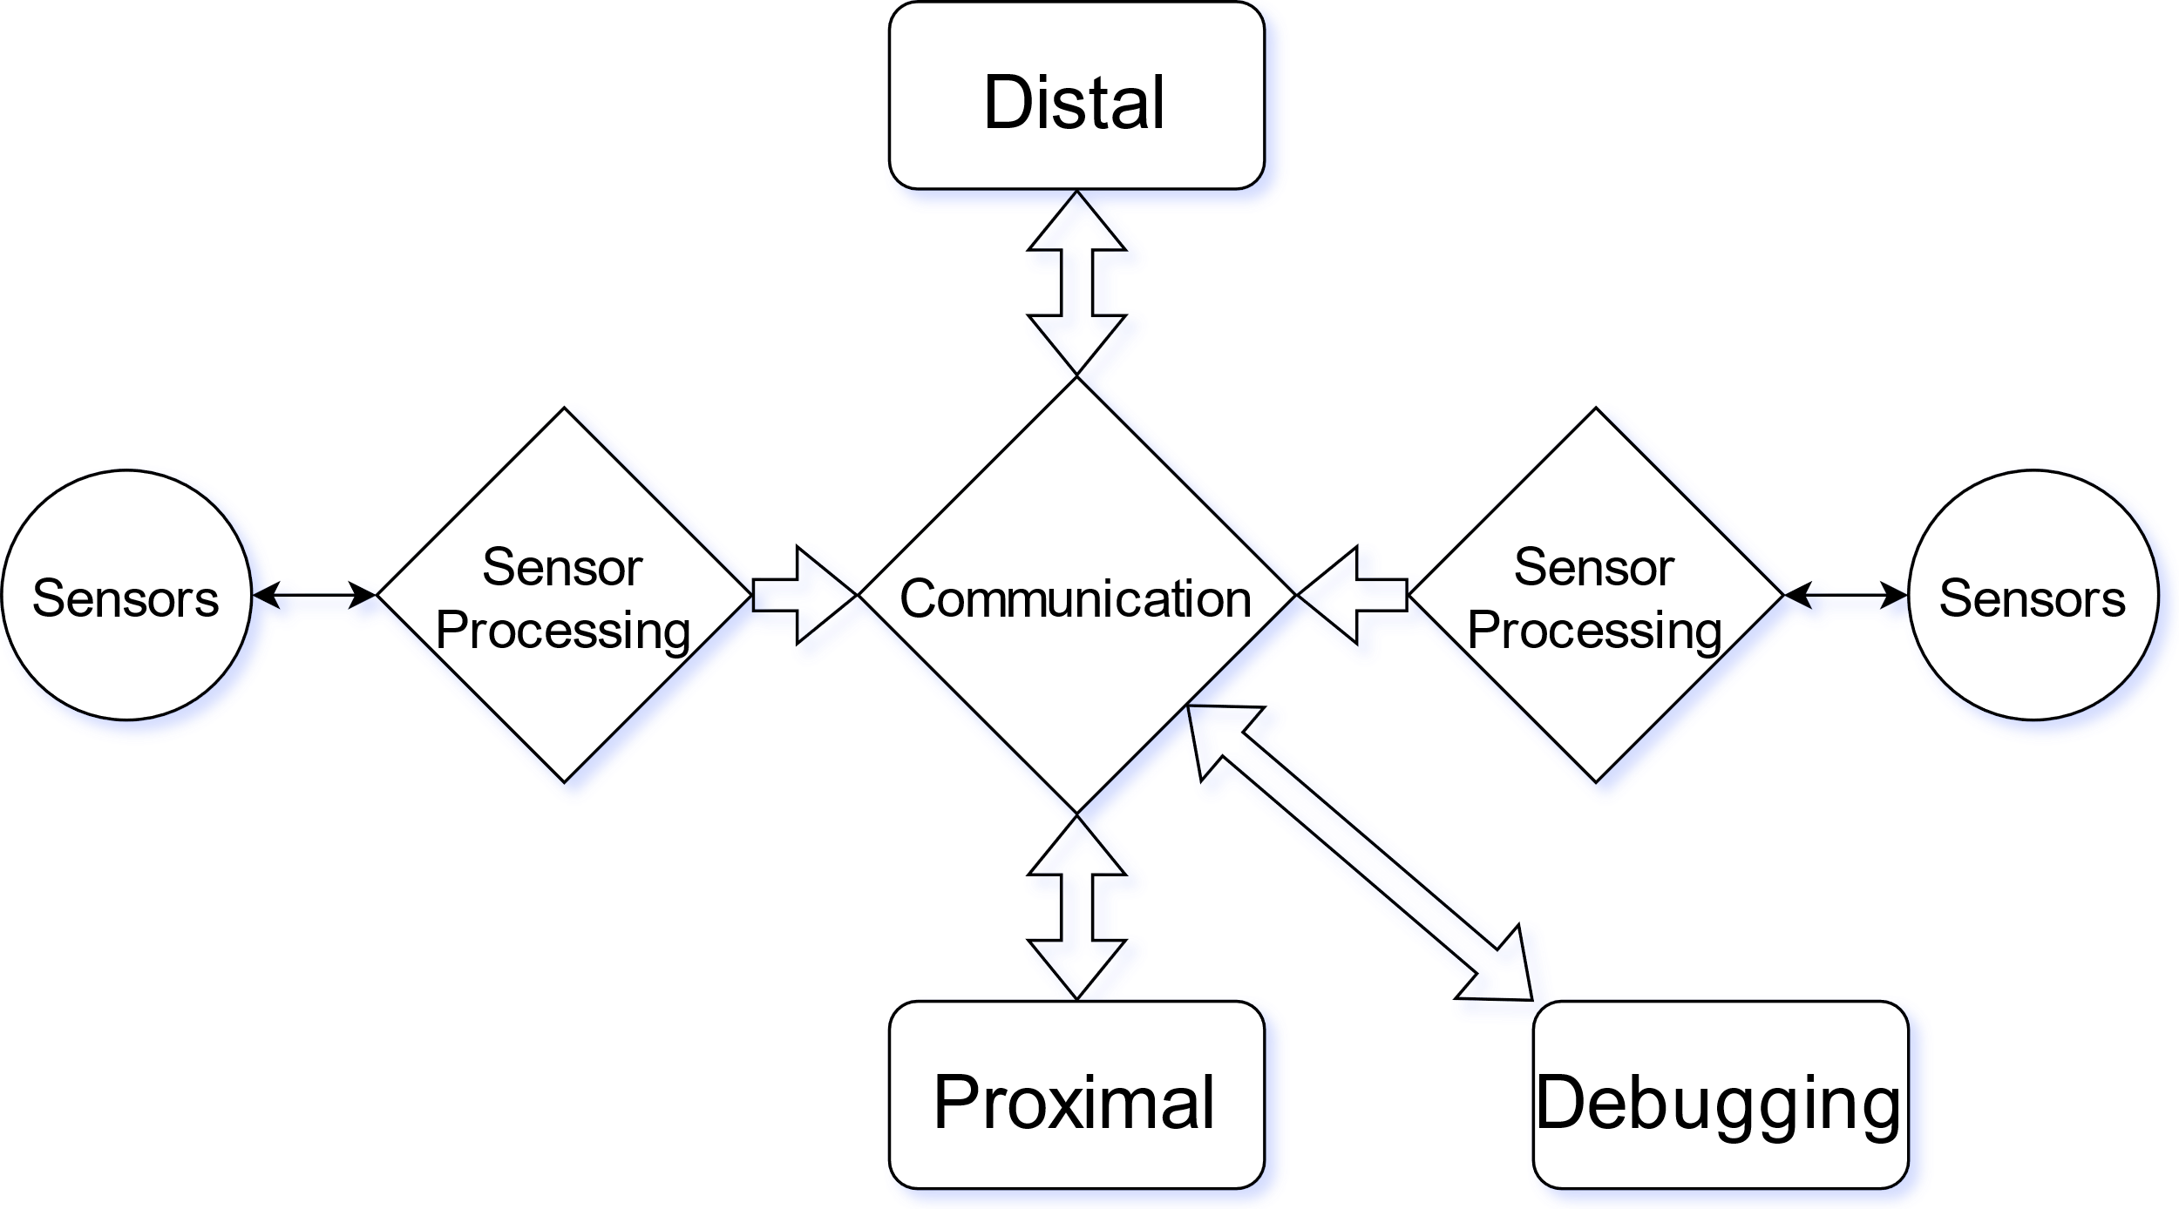
Simplified Model

Slide 38
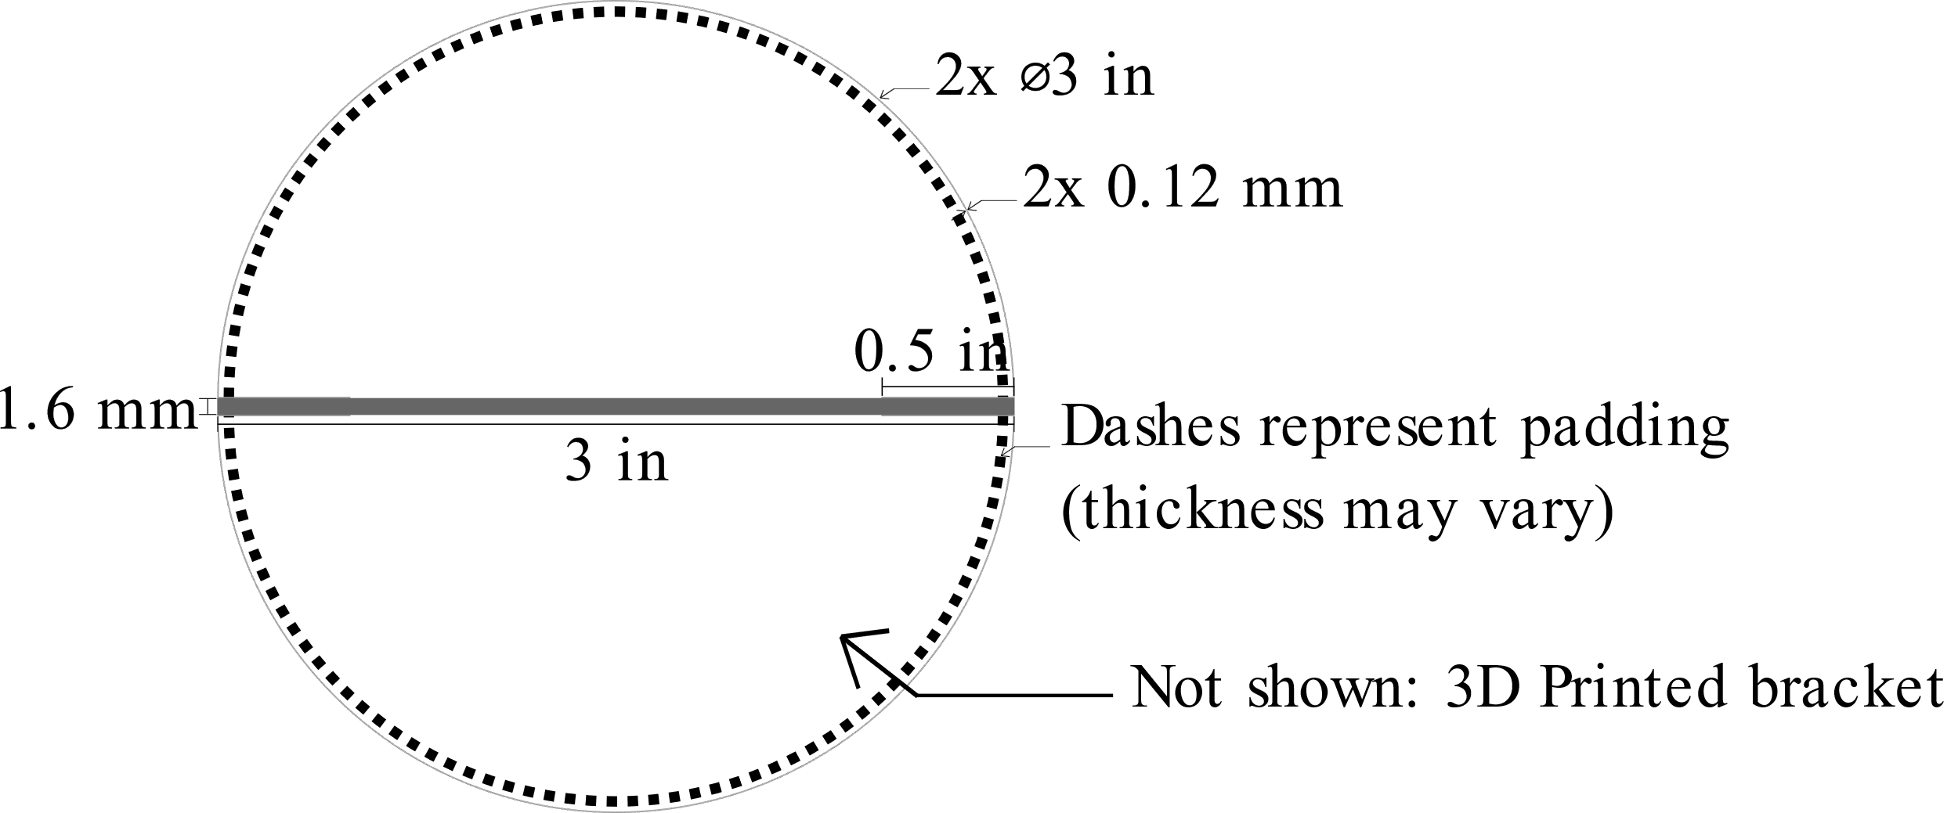
Limb Segment
>
¼ inch

Slide 39
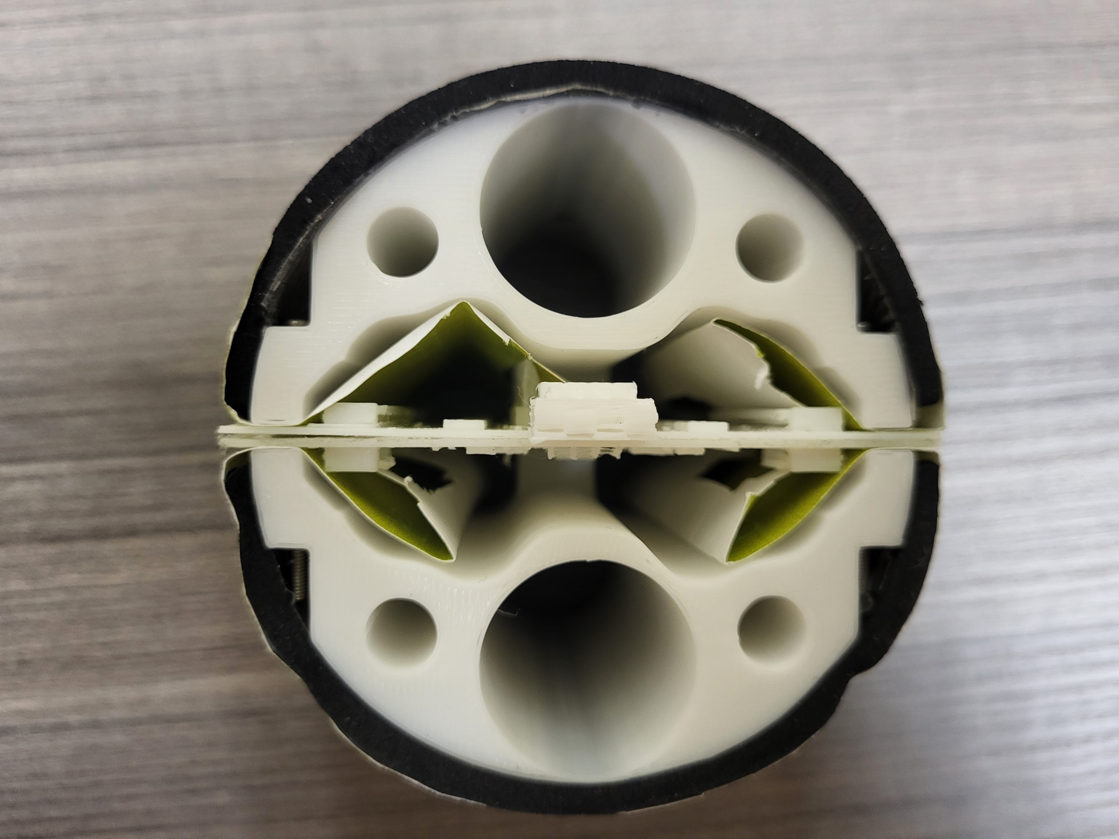

Slide 40
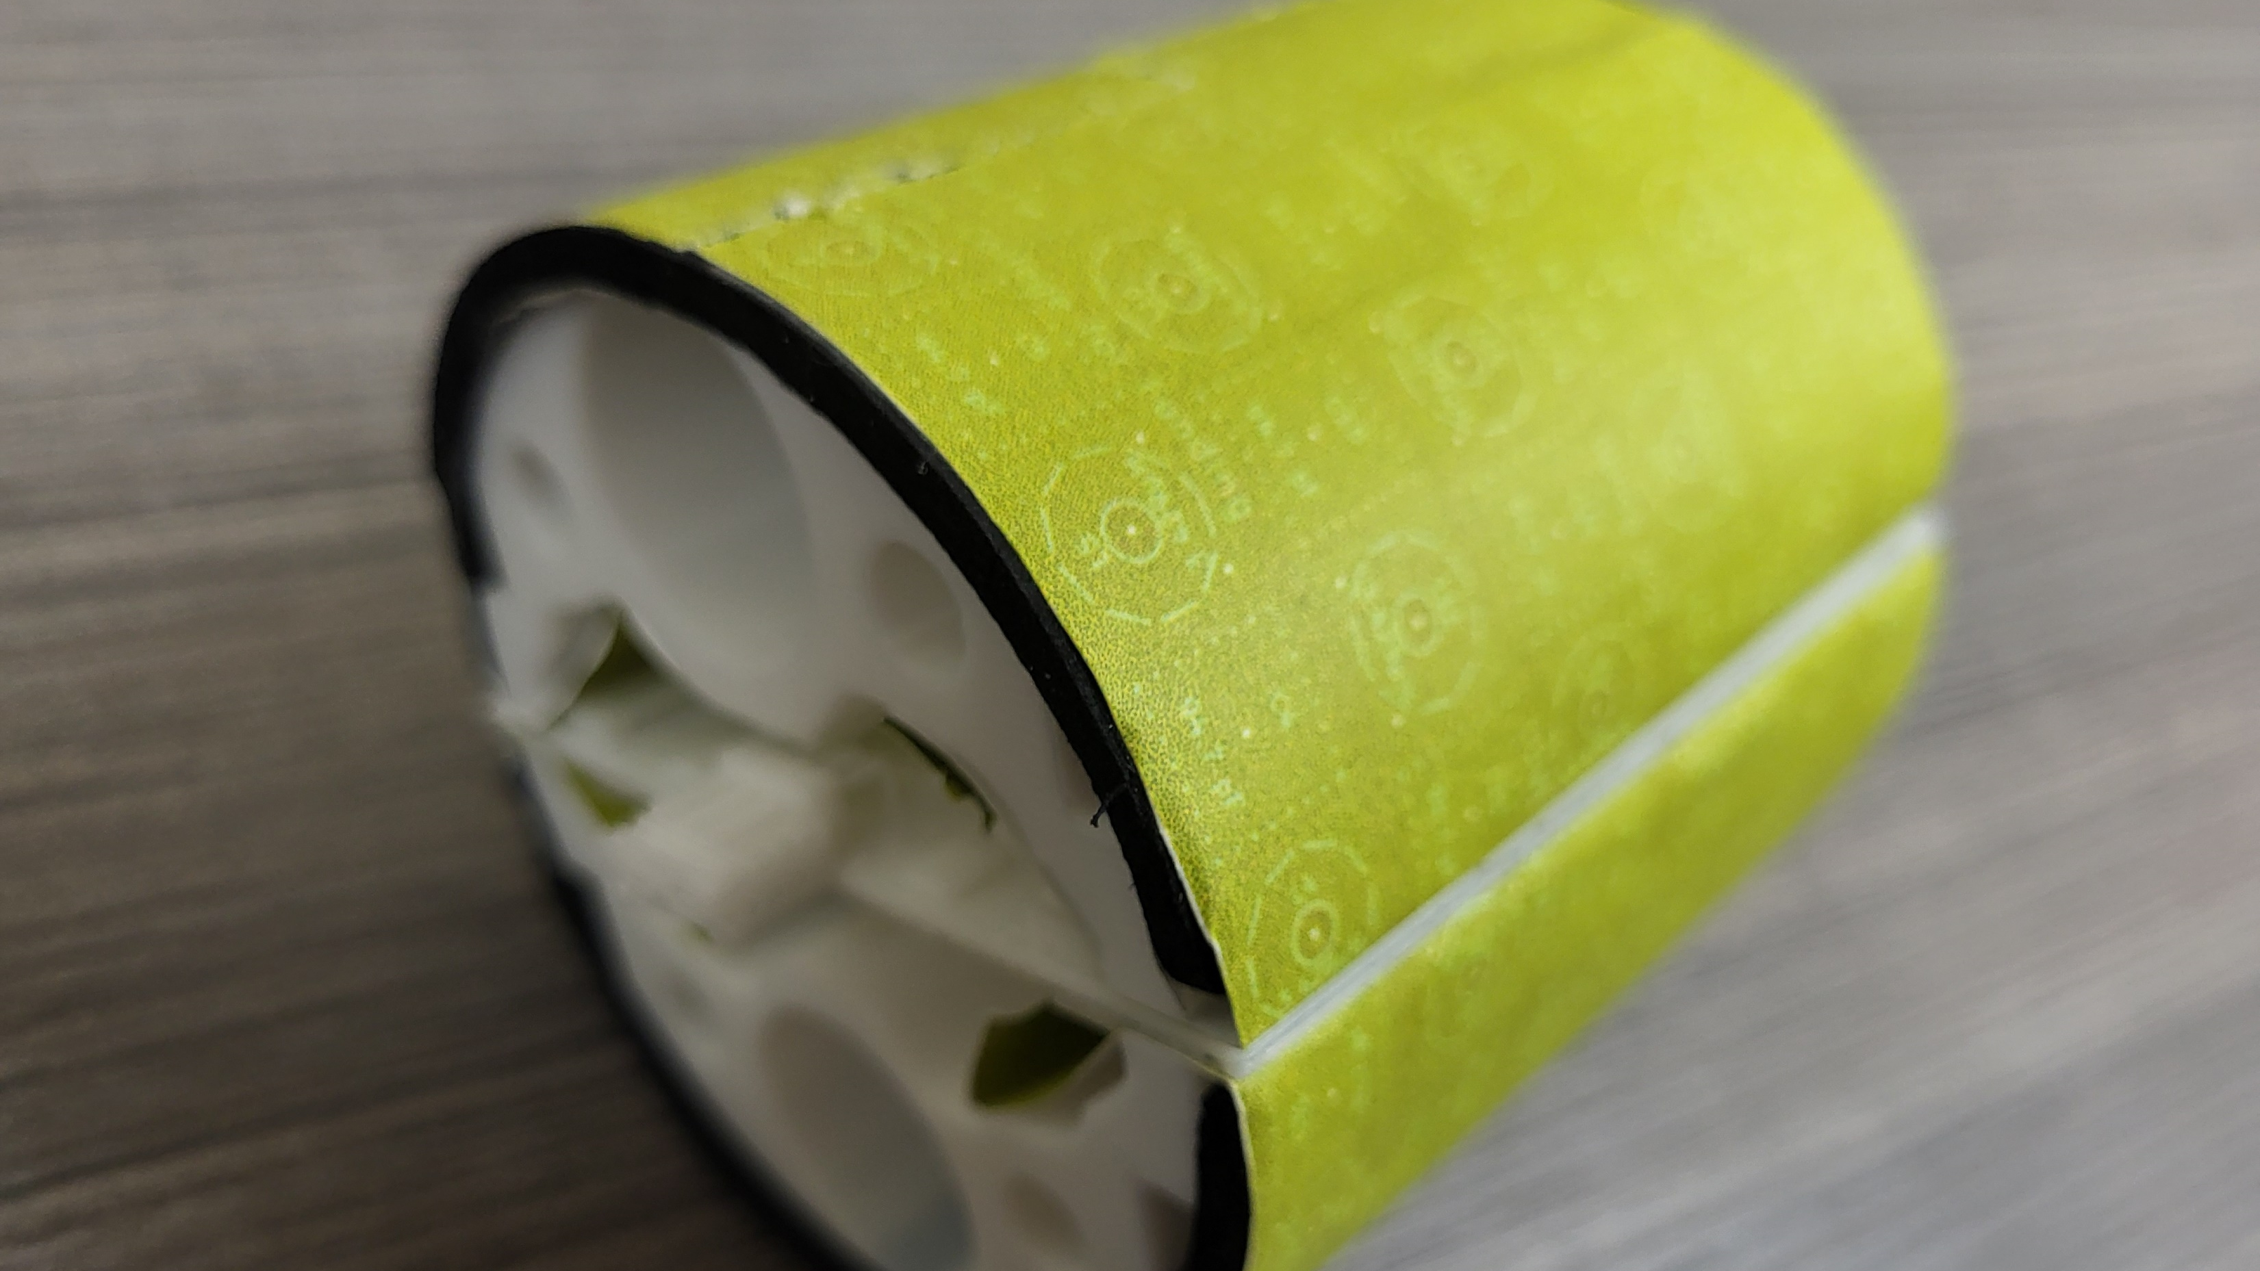

Slide 41

Communications Method Options
Limited scalability
Complex arm programming
Traditional networking – IP addressing & GOOSE/DNP3
Onion-tree routing
Input Modification Routing
Vector Input Modification
Machine Learning Neuron
Neuron-integrated neural network input modification
Limited scalability
Traditional networking – IP addressing & GOOSE/DNP3
Onion-tree routing
Input Modification Routing
Vector Input Modification
Machine Learning Neuron
Neuron-integrated neural network input modification
Biological neuron chemical neurotransmitter simulation
Error-prone
Likely too high resource cost on RP2040s

Slide 42
Goals after Production
Design and build joints, central controller
Program the CPUs
Communication and control experiments
Write Thesis
Present at URS
Present at ASEE Conference

Slide 43
Overview of PCB Design
2:10

Slide 44
Overview of PCB Design
PCB – Printed Circuit Board
Electronic circuit acid-etched onto copper
Multiple layers
Components – resistors, integrated circuits, etc.

Slide 45
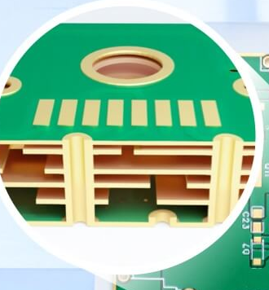
Multiple Layers
Components on outer layers
Signals/Power on inner layers
Solder Spots called “pads”
Wires called “traces”
“Vias” connect layers
Image Source: JLCPCB (https://jlcpcb.com/) Feb. 16, 2025

Slide 46
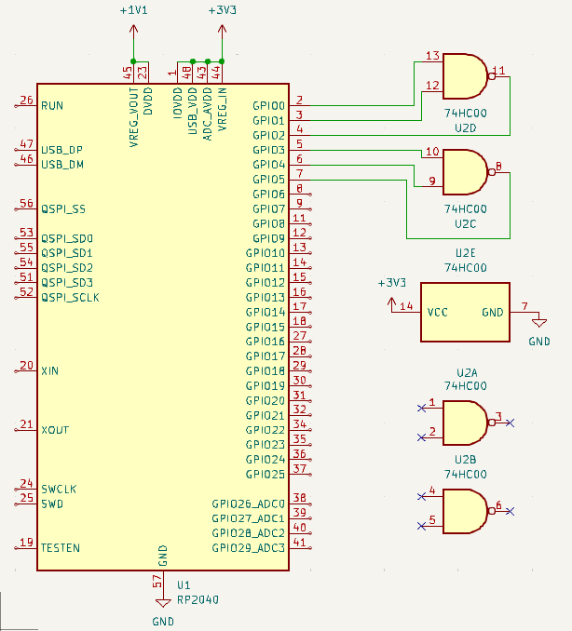
Design Process
Select Major Components – CPUs, connectors, etc.
Place components on schematic, select “footprint”
Connect Pins
Send to PCB Design
This design is simplified and would not actually work.

Slide 47
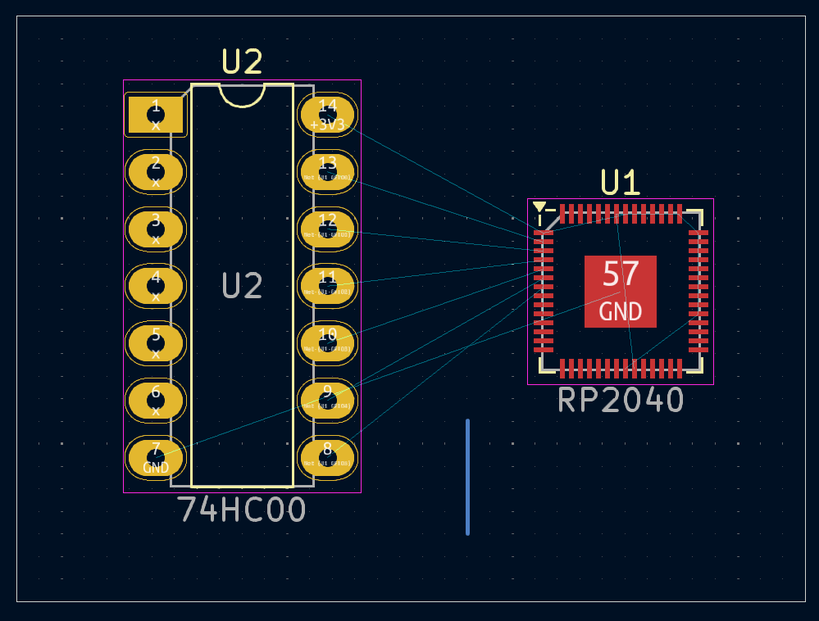
Design Process
Setup CAD Software
Define Board Edge
Place “footprints” where desired.

Slide 48
Color meaning
Yellow – Printed on Board
Gold – Copper on all layers
Blue lines – pads should connect
Red – Copper on top layer
Pink and thick gray – component area
Thin gray – board outline (cuts)
Blue – Copper on bottom layer

Slide 49
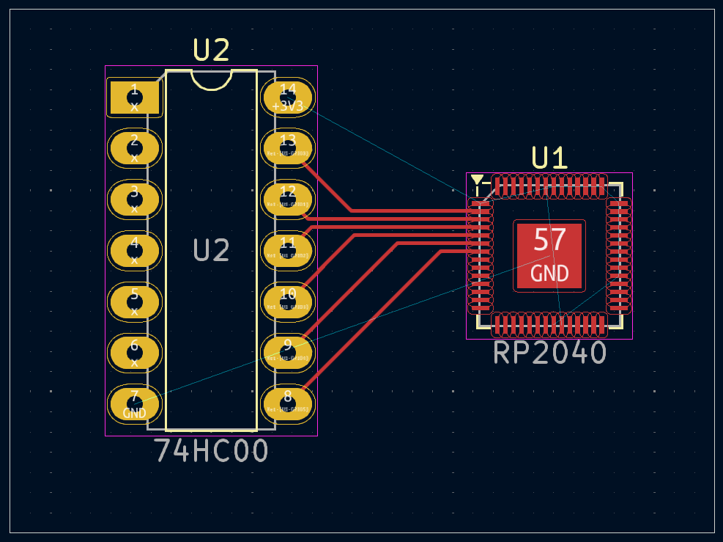
Design Process
Run traces between pads which need to connect.

Slide 50
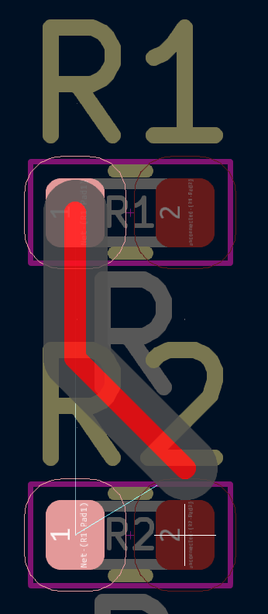
Modern CAD Software will not allow connecting the wrong pads

Slide 51
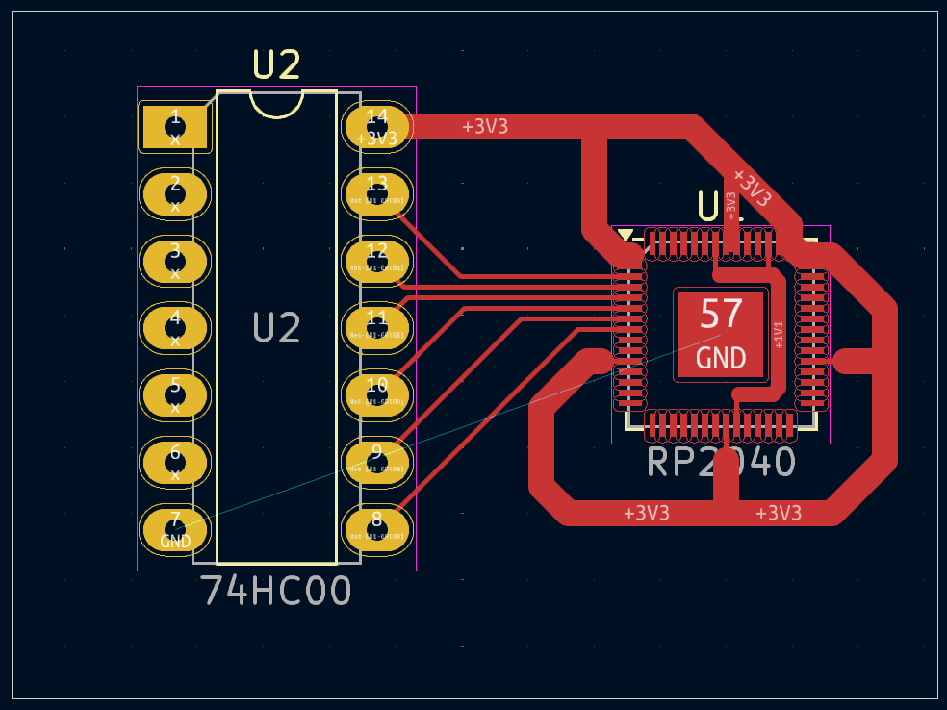
Design Process
Power pins need thicker traces, however…

Slide 52
Design Process
… It’s good practice to use fill zones

Slide 54
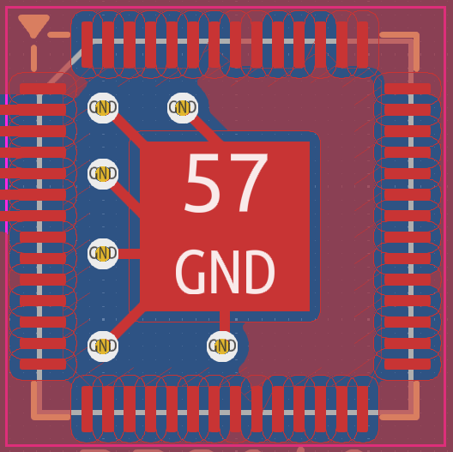
Design Process
Use vias to connect copper between layers.

Slide 55

Other considerations
Thermal spokes for easy soldering

Slide 56
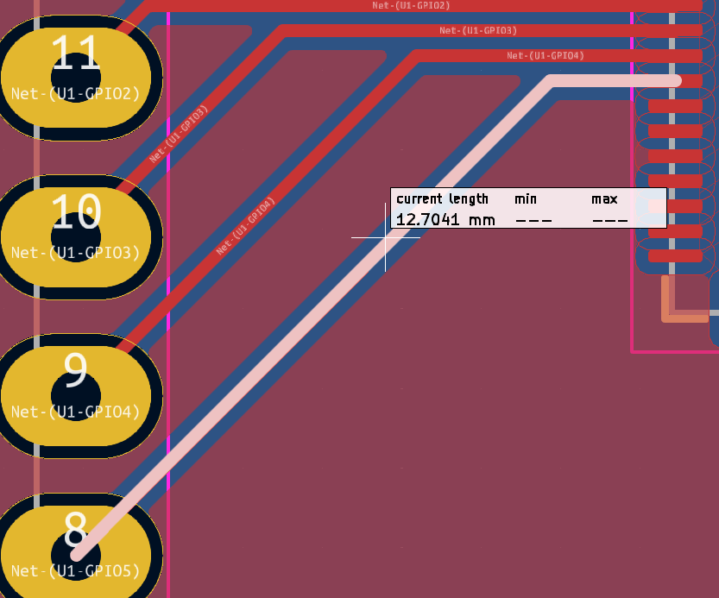
Other considerations
Length tuning
Minimize signal delay difference

Slide 57
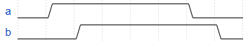
Other considerations
Signal delayed

Slide 58
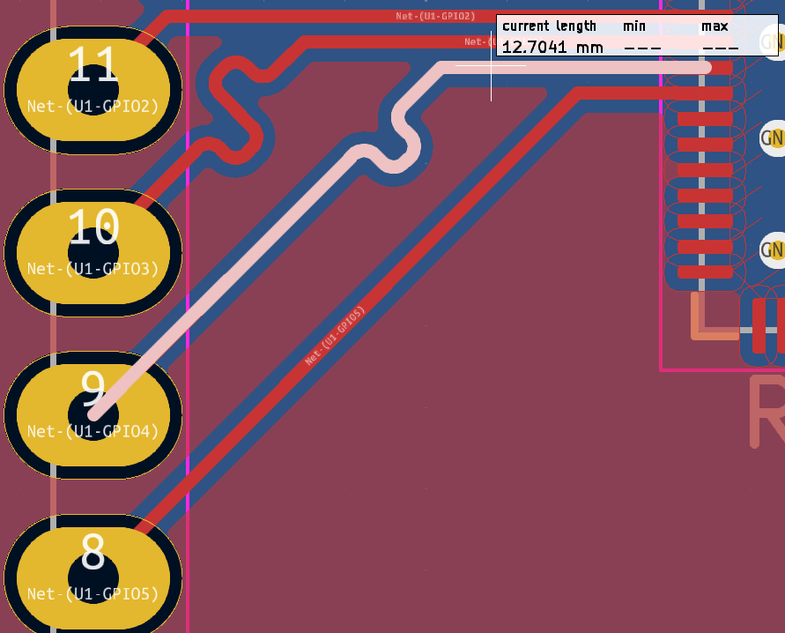
Other considerations
Bent track increases delay

Slide 59
Other Considerations
Pullup/down resistors
Decoupling capacitors

Slide 60


What are these?
Resistor
Capacitor
FREE
Cars!

Slide 61
Original (Scrapped) Design
2:15

Slide 62
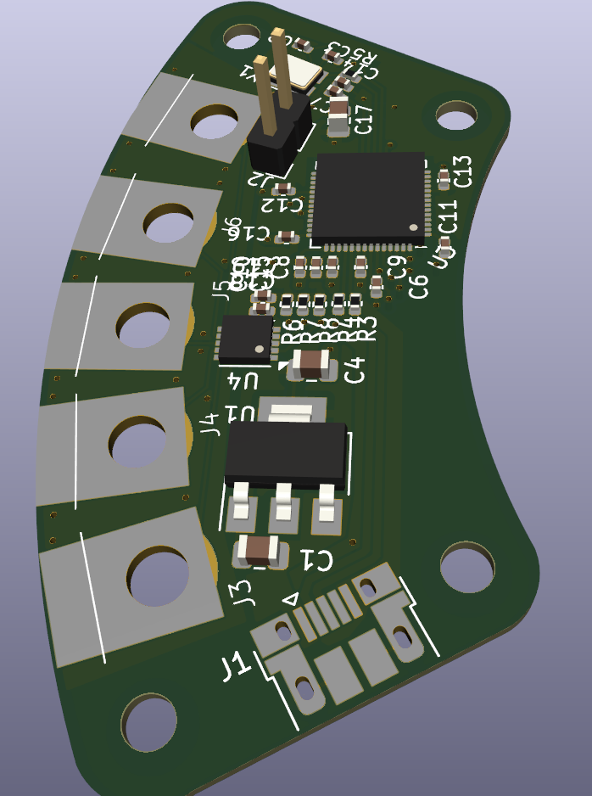
Original Concept

Slide 63
Original Concept
6 modules/in
Wrap around PVC
Right angle screw things

Slide 64
Issues with original design
USB Port
Cost
Right angle screw things!
Inefficient IO usage – 1 sensor controller per module!
$8500 for 5 feet!
Space

Slide 65
Original Concept

Slide 66
Current Design
2:18

Slide 67
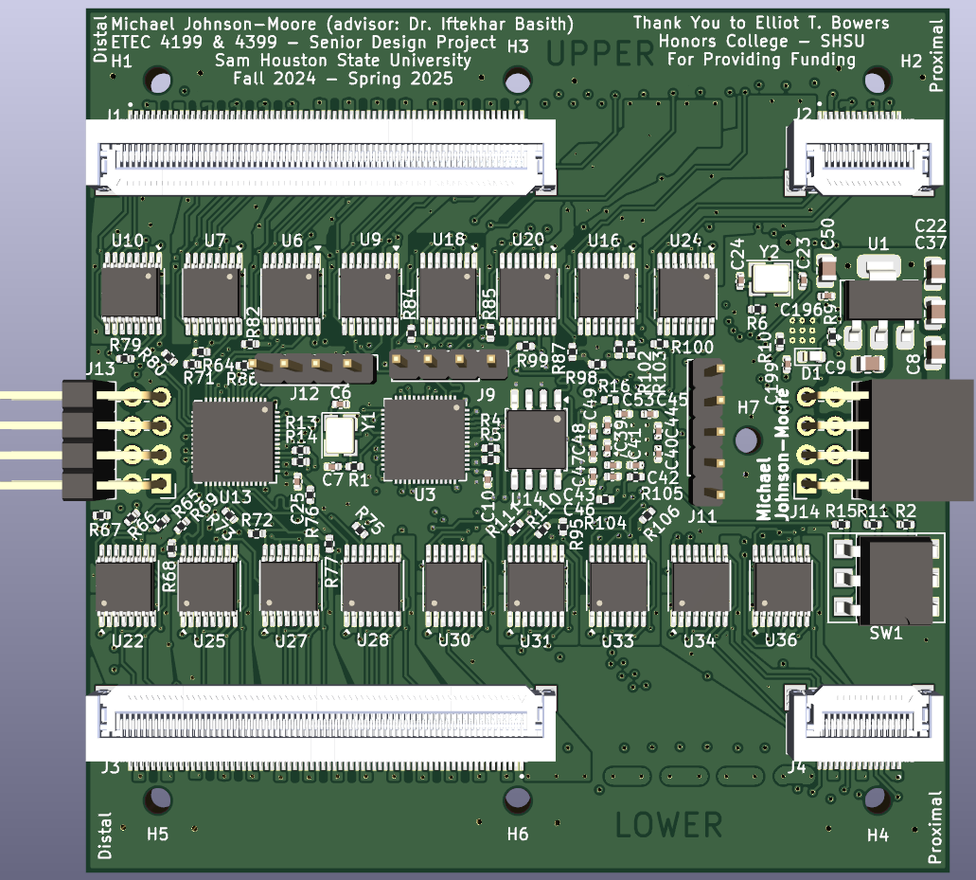
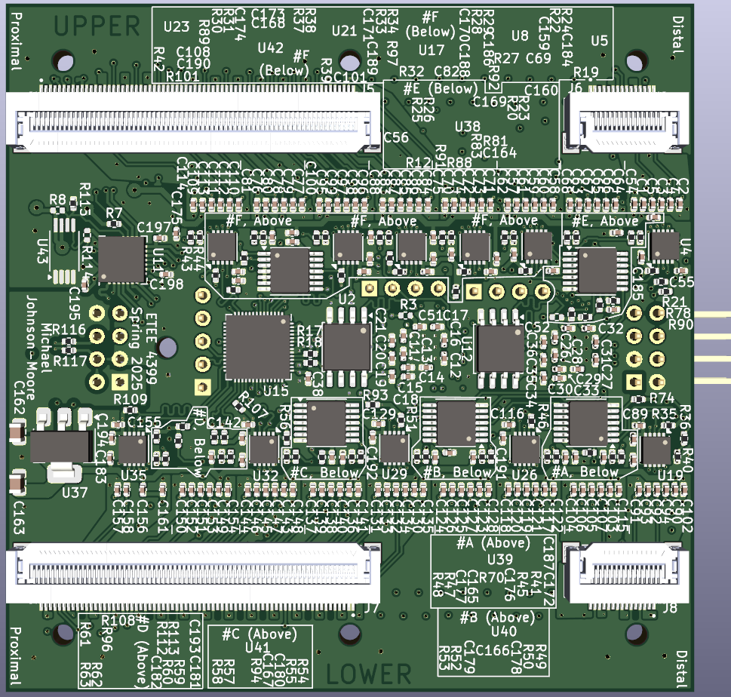
Current (Final?) Board

Slide 68
Connectors and Mounting Holes
For Sensor Board
Amphenol F31L-1A7H1-11070 and F31L-1A7H1-11015
Many pins! Discontinued?

Slide 69
Connectors and Mounting Holes
For Sensor Board
Amphenol F31L-1A7H1-11070 and F31L-1A7H1-11015
Many pins! Discontinued?

Slide 70
Connectors
For segment connections
Metz Connect FR202XXHBDN and PR202XXHBDN
Compatible! Discontinued?

Slide 71
Connectors
For segment connections
Metz Connect FR202XXHBDN and PR202XXHBDN
Compatible! Discontinued?

Slide 72
RP2040 layout
Raspberry Pi RP2040
Used in Pico
Cheap - $1.00 (≈$4.00 w/ requirements)
Fast enough – 133 MHz
Much faster than Arduino Uno – 16 MHz
Large number of I/O pins

Slide 73
RP2040 layout
Raspberry Pi RP2040
Used in Pico
Cheap - $1.00 (≈$4.00 w/ requirements)
Fast enough – 133 MHz
Much faster than Arduino Uno – 16 MHz
Large number of I/O pins

Slide 74
Required By RP2040
NAND Flash (storage) – Winbond W25Q128JVS
W25Q128JVSIQ variant for 4 data lines

Slide 75
Required By RP2040
12 MHz Clock crystal – Abracon ABM8-272-T3

Slide 76
Required By RP2040
3.3V Voltage regulator – Onsemi NCP1117

Slide 77
Required By RP2040
1 μF low ESR capacitors
Shipment delay
Various other resistors and capacitors

Slide 78
LDC3114 Inductive Sensor Controllers
12.5 mm
Texas Instruments LDC3114QPWRQ1
Automotive version
NOT cheap, no minimum order
Not small
LDC2114 is available small
Complicated

Slide 79
LDC3114 Inductive Sensor Controllers
Texas Instruments LDC3114QPWRQ1
Automotive version
NOT cheap, no minimum order
Not small
LDC2114 is available small
Complicated

Slide 80
Current (Final?) Board

Slide 81
Required by LDC3114
A low capacitance, low ESR, low ESL capacitor
C0402C222J3GACAUTO
Various other resistors and capacitors

Slide 82
Required by LDC3114
Copper fill
Specially designed spiral

Slide 83
CAP1206 Capacitive sensor controllers
2-4 mm
Microchip CAP1206-TR-AIA
Cheap, decent number of channels
Simple
Small
Requires various resistors and capacitors

Slide 84
CAP1206 Capacitive sensor controllers
Microchip CAP1206-TR-AIA
Cheap, decent number of channels
Simple
Small
Requires various resistors and capacitors

Slide 85
USB HUB

Slide 86
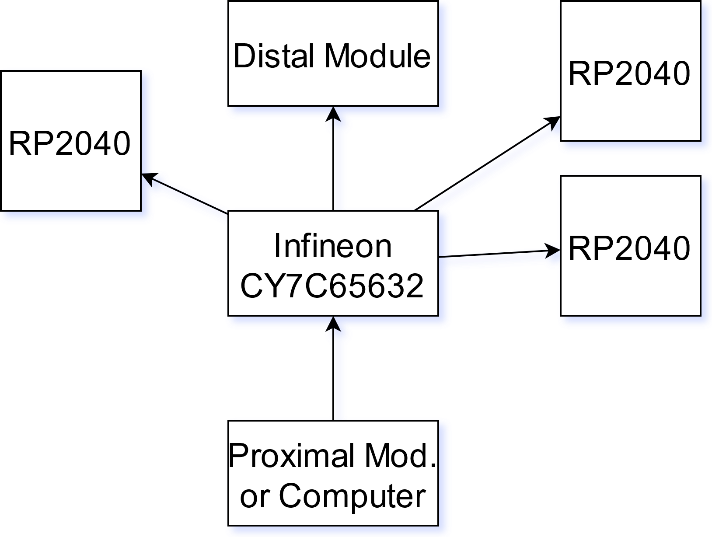
USB HUB Controller
Infineon CY7C65632-28LTXCT
Four downstream USB ports
1 to each RP2040
1 to next module
Cheap
Small

Slide 87
Required by USB HUB
EEPROM (Storage) – limited, discontinued options
Optional

Slide 88
Required by USB HUB
EEPROM (Storage) – limited, discontinued options
Optional

Slide 89
Required by USB HUB
12 MHz Clock crystal – Abracon ABM8-272-T3
Can’t share ☹

Slide 90
Required by USB HUB
LED – optional?

Slide 91
Required by USB HUB
649 Ω resistor – RT0402BRD07649RL
Tolerance? – ±0.1%
Various other resistors and capacitors

Slide 92
Current (Final?) Board

Slide 93
Logic Gates
Texas Instruments SN74HCS30PWR and SN74HC32PWR
Discrete logic gates (NAND and OR).

Slide 94
Current (Final?) Board

Slide 95
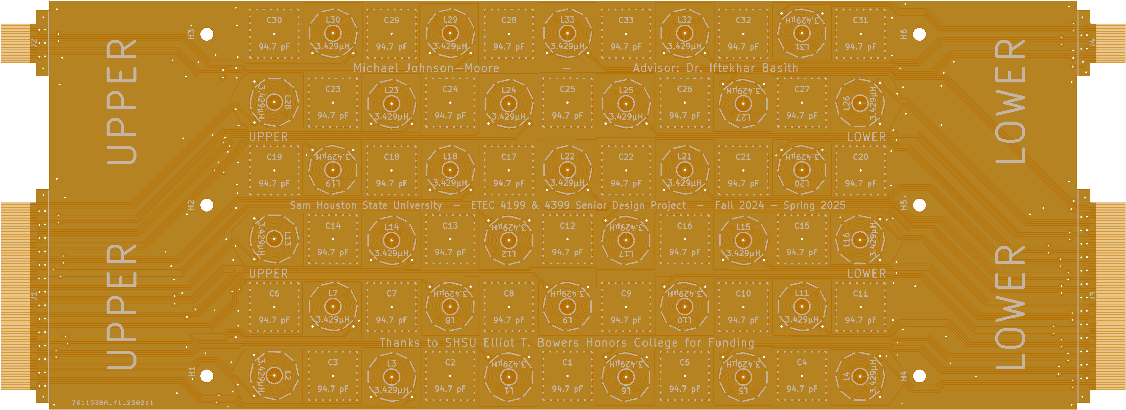
Sensing Board
Image Source: JLCPCB Engineers
I paid for this image to be produced.

Slide 96
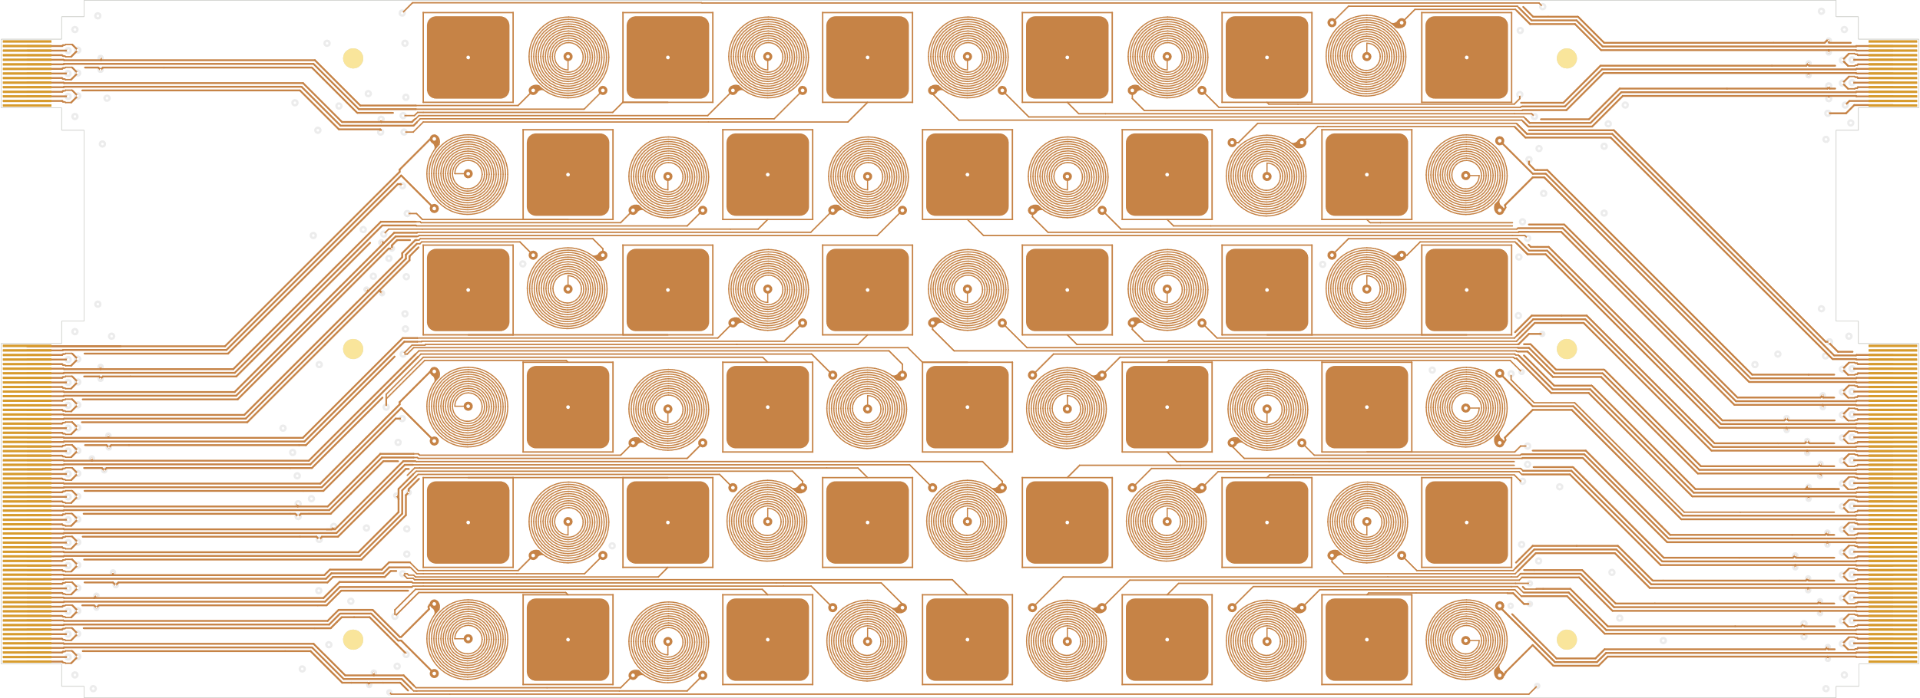
Sensing Board

Slide 97
Sensing Board Up Close

Slide 98
Issues Encountered
2:31

Slide 99
EAR99
JLCPCB requires EAR99 if IC
EAR99 – US export regulation?
Repurchased some parts

Slide 100
LDC2114 Size
Kicad footprint - 0.5 mm pitch
Actual component - 0.4 mm pitch
Not manufacturable

Slide 101
Bad component choices
CAP1208? CAP1214?
esp32?
Discontinued stuff

Slide 102
RP2040 GPIO USAGE
RP2040 supports 2 active I2C channels.
Workaround.
I2C multiplexer?
102

Slide 103
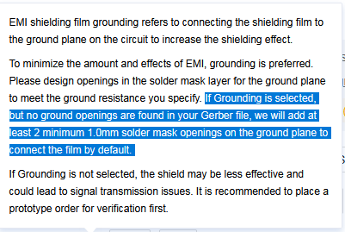
Manufacturer Confusion
Engineers thought Test Points Desired
Don’t expect English
Don’t assume contractors read

Slide 104
Component Delays

Slide 105
Component Delays

Slide 106
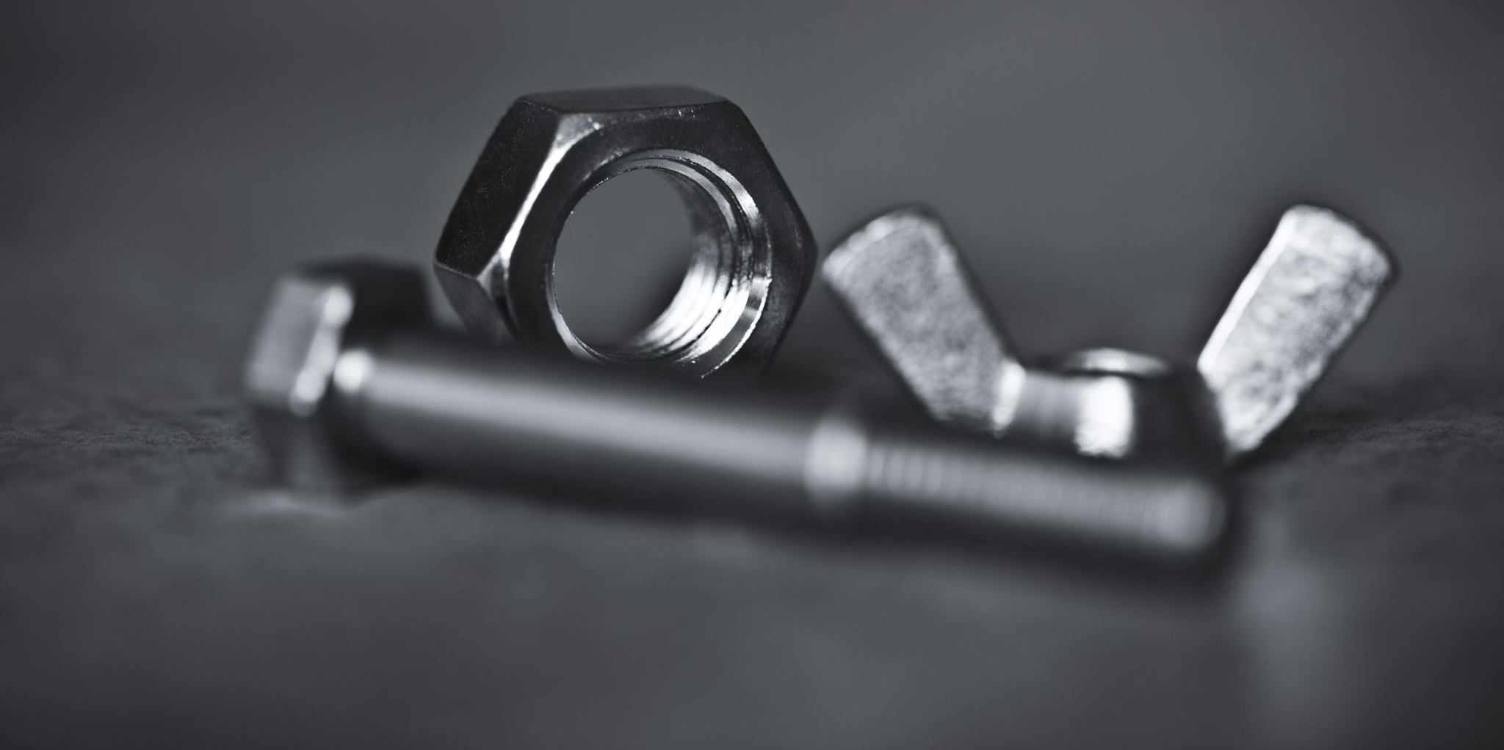

Assembly
Screws take up space
106

Slide 107
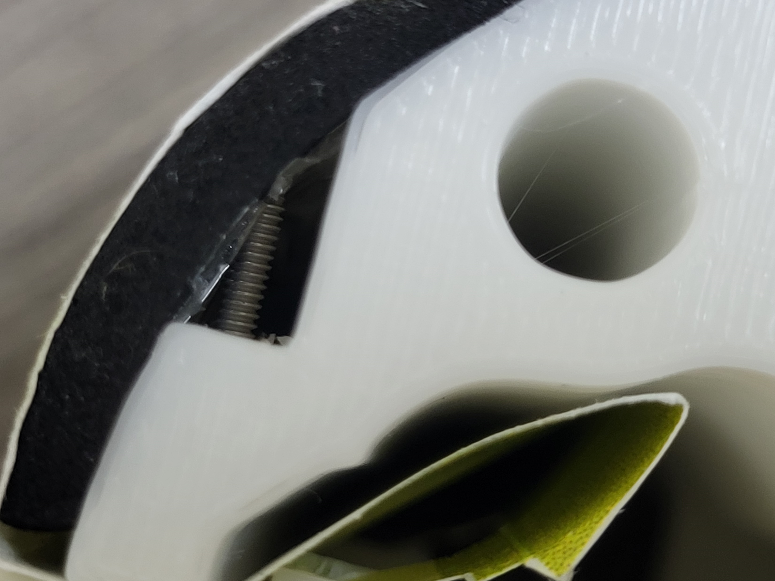

Slide 108
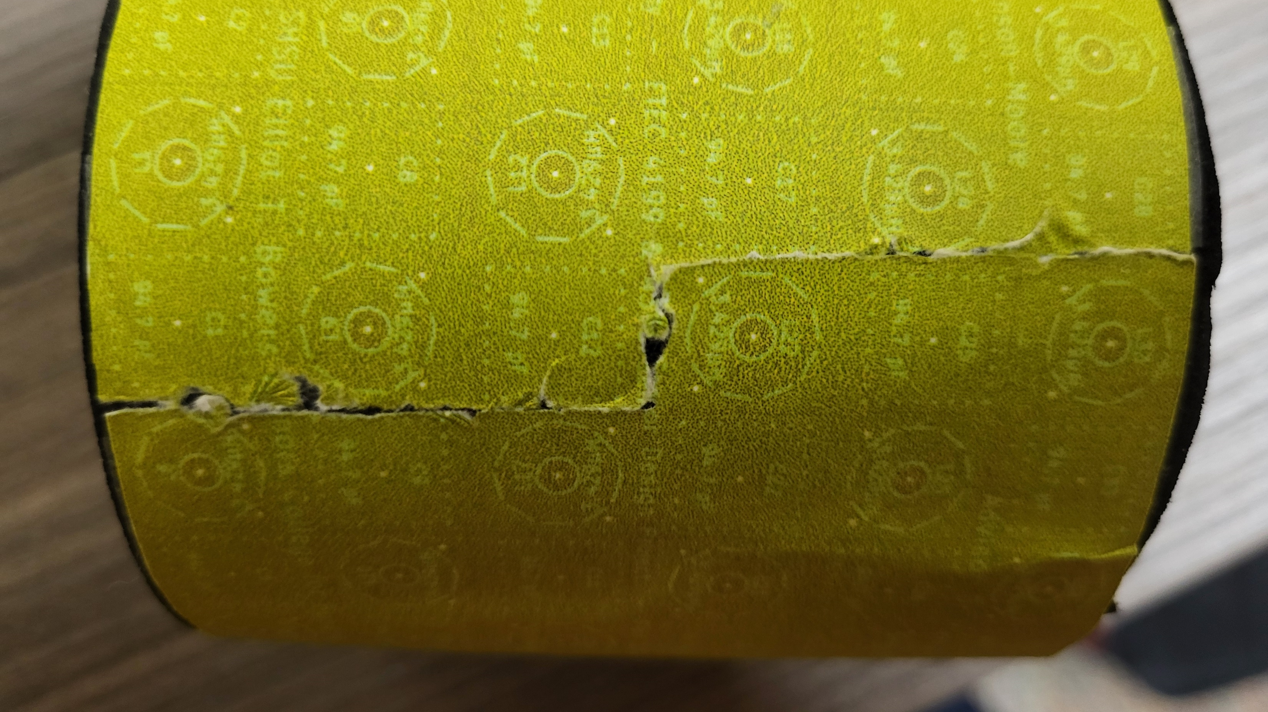

Slide 109
Raspberry Pi RP235xX
RP2040
RP235xX
133 MHz
264 kB RAM
External storage
150 MHz (++performance)
520 kB RAM
[Optional] internal storage

Slide 110
References
D. Hou and D. Dolezilek, “IEC 61850 – what it can and cannot offer to traditional protection schemes,” SEL Journal of Reliable Power, vol. 1, no. 2, Oct. 2010. [Online]. Available: https://cdn.selinc.com/assets/Literature/Publications/Technical%20Papers/6335_IEC61850_DH-DD_20080912_Web.pdf
R. Lent, F. A. C. Azevedo, C. H. Andrade-Moraes, and A. V. O. Pinto, “How many neurons do you have? some dogmas of quantitative neuroscience under revision,” European Journal of Neuroscience, vol. 35, no. 1, pp. 1–9, 2012. [Online]. Available: https://onlinelibrary.wiley.com/doi/abs/10.1111/j.1460-9568.2011.07923.x
M. Islam, G. Chen, and S. Jin, “An overview of neural network,” American Journal of Neural Networks and Applications, vol. 5, no. 1, pp. 7–11, 2019. [Online]. Available: https://doi.org/10.11648/j.ajnna.20190501.12
(2021, Aug.) Inductive sensing design calculator tool. Texas Instruments. [Online]. Available: https://www.ti.com/tool/download/ LDC-CALCULATOR-TOOLS
RP2040 Datasheet: A microcontroller by Raspberry Pi, eec2b0cclean ed., Raspberry Pi, Oct. 2024. [Online]. Available: https://datasheets.raspberrypi.com/rp2040/rp2040-datasheet.pdf
Raspberry Pi Pico Pinout, Raspberry Pi. [Online]. Available: https://datasheets.raspberrypi.com/pico/Pico-R3-A4-Pinout.pdf
Hardware design with RP2040: Using RP2040 microcontrollers to build boards and products, 2nd ed., Raspberry Pi, Oct. 2024. [Online]. Available: https://datasheets.raspberrypi.com/rp2040/hardware-design-with-rp2040.pdf
spiflash® 3V 128M-BIT SERIAL FLASH MEMORY WITH DUAL/QUAD SPI & QPI & DTR, C ed., winbond, Mar.2018. [Online]. Available: https://www.winbond.com/resource-files/w25q128jv_dtr%20revc%2003272018%20plus.pdf
1.0 A Low-Dropout Positive Fixed and Adjustable Voltage Regulators NCP1117, NCP1117I, NCV1117, 31st ed., onsemi, Aug. 2021. [Online]. Available: http://www.onsemi.com/pub_link/Collateral/NCP1117-D.PDF
CAP1206: 6-Channel Capacitive Touch Sensor, DS00001567B ed., Microchip Technology, Nov. 2015. [Online]. Available: https://www.microchip.com/en-us/product/cap1206
LDC3114 4-Channel Hybrid Inductive Touch and Inductance to Digital Converter, 1st ed., Texas Instruments, Dec. 2021. [Online]. Available: https://www.ti.com/lit/ds/symlink/ldc3114.pdf
LDC2112, LDC2114 Inductive Touch Solution for Low-Power HMI Button Applications, B ed., Texas Instruments, Jan. 2017. [Online]. Available: https://www.ti.com/lit/ds/symlink/ldc2114.pdf
SN5430, SN54LS30, SN54S30, SN7430, SN74LS30, SN74S30, 8-Input Positive-NAND Gates, Texas Instruments, Mar. 1988. [Online]. Available: https://www.ti.com/lit/ds/symlink/sn74ls30.pdf
SN5432, SN54LS32, SN54S32, SN7432, SN74LS32, SN74S32, Quadruple 2-Input Positive-OR Gates, Texas Instruments, Mar. 1988. [Online]. Available: https://www.ti.com/lit/ds/symlink/sn74ls32.pdf
CY7C65632, CY7C65634: HX2VL - Very Low-Power USB 2.0 Hub Controller, O ed., infineon, Oct. 2024. [Online]. Available: https://www.infineon.com/dgdl/Infineon-CY7C65632_CY7C65634_HX2VL_VERY_LOW-POWER_USB_2.0_HUB_CONTROLLER-DataSheet-v14_00-EN.pdf?fileId=8ac78c8c7d0d8da4017d0ecd35994769&utm_source=cypress&utm_medium=referral&utm_campaign=202110_globe_en_all_integration-files&redirId=File_1_1_521
Data sheet: FR202xxHBDN, W ed., Metz Connect, Dec. 2024. [Online]. Available: https://media.metz-connect.com/files/171/Data_sheet_FR202XXHBDN.PDF
Data sheet: PR202xxHBDN, W ed., Metz Connect, Dec. 2024. [Online]. Available: https://media.metz-connect.com/files/171/Data_sheet_PR202XXHBDN.PDF
2:41

Slide 111

Questions?

